Slide 1

Hand on Lab VI: Clustering
K-Means

Slide 2
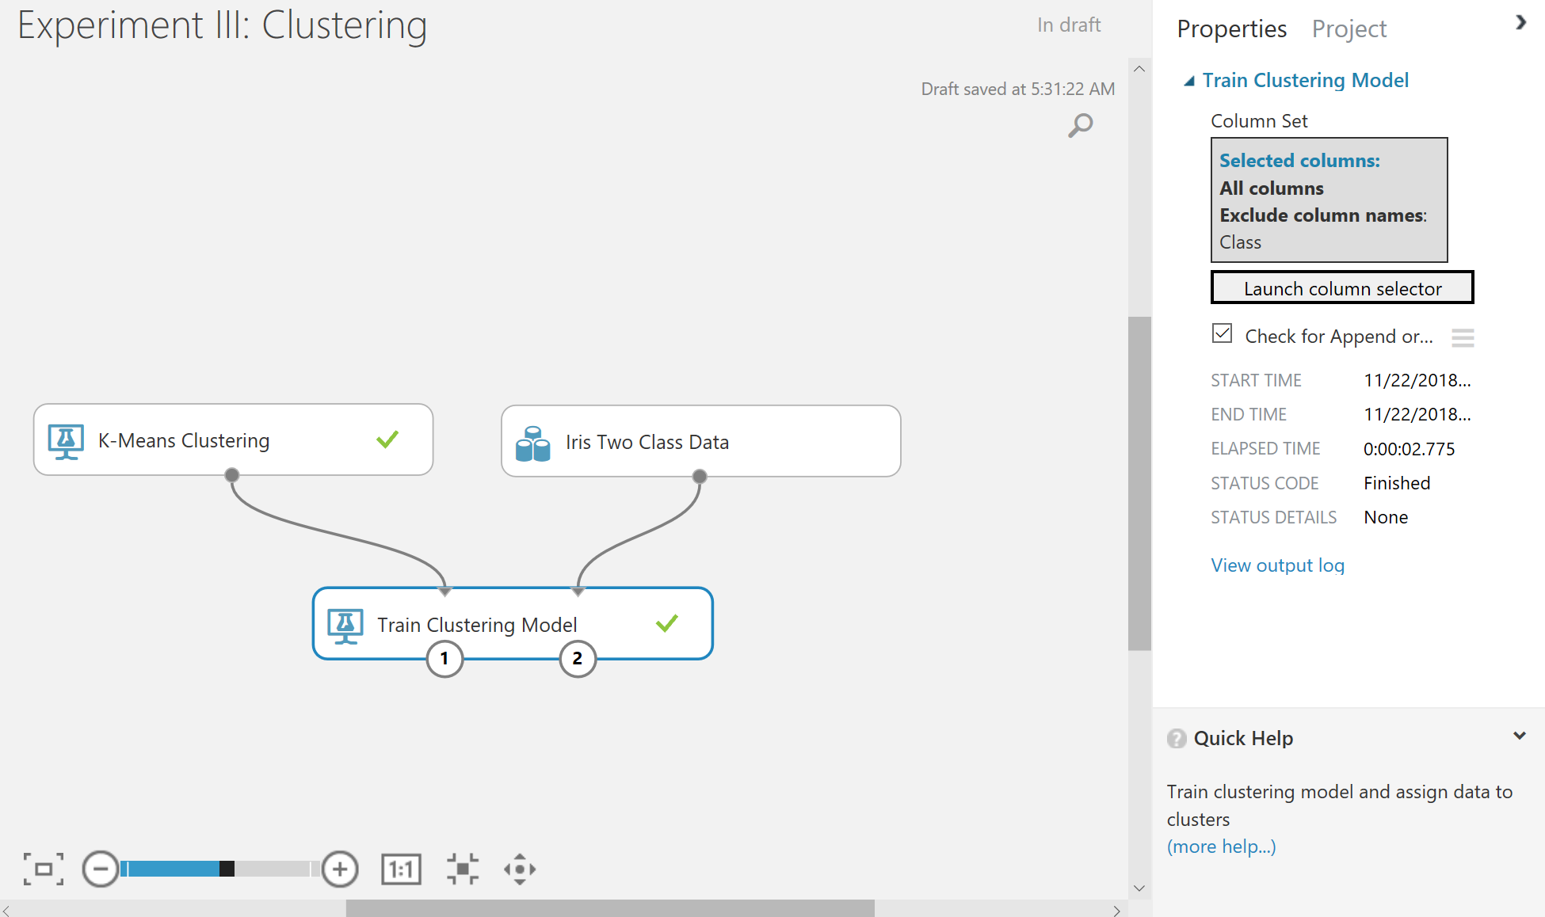
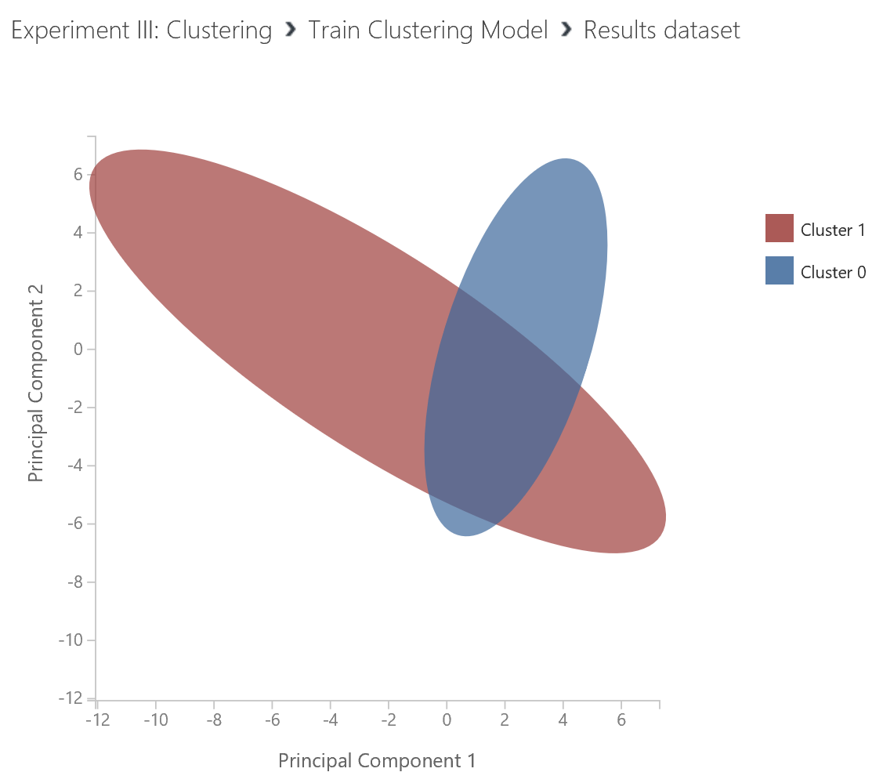
Clustering – K-Means
Exclude label

